Slide 1
Generators,
Itertools
and Decorators

Slide 2
Generators

Slide 3
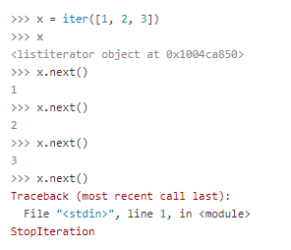
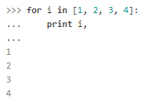
Generators
Iterator
Generator: Generate an Iterator

Slide 4
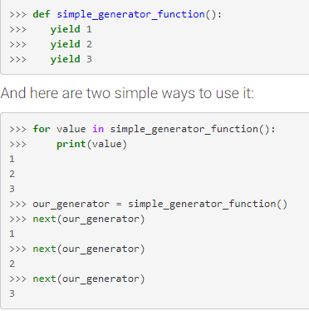
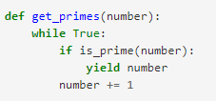
Generators
Magic word: yield
function + yield = generator
cons:
Infinite Iterator
Low Memory cost
Organized

Slide 5
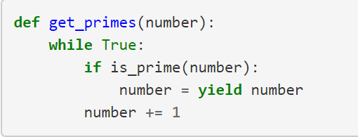

Generators
Send value to the iterator:

Slide 6
Iter tools
Python module to create iterators

Slide 7
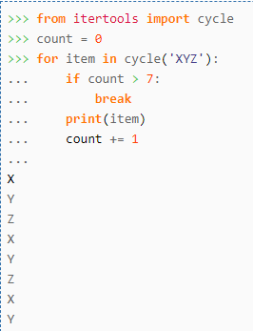
Cycle

Slide 8
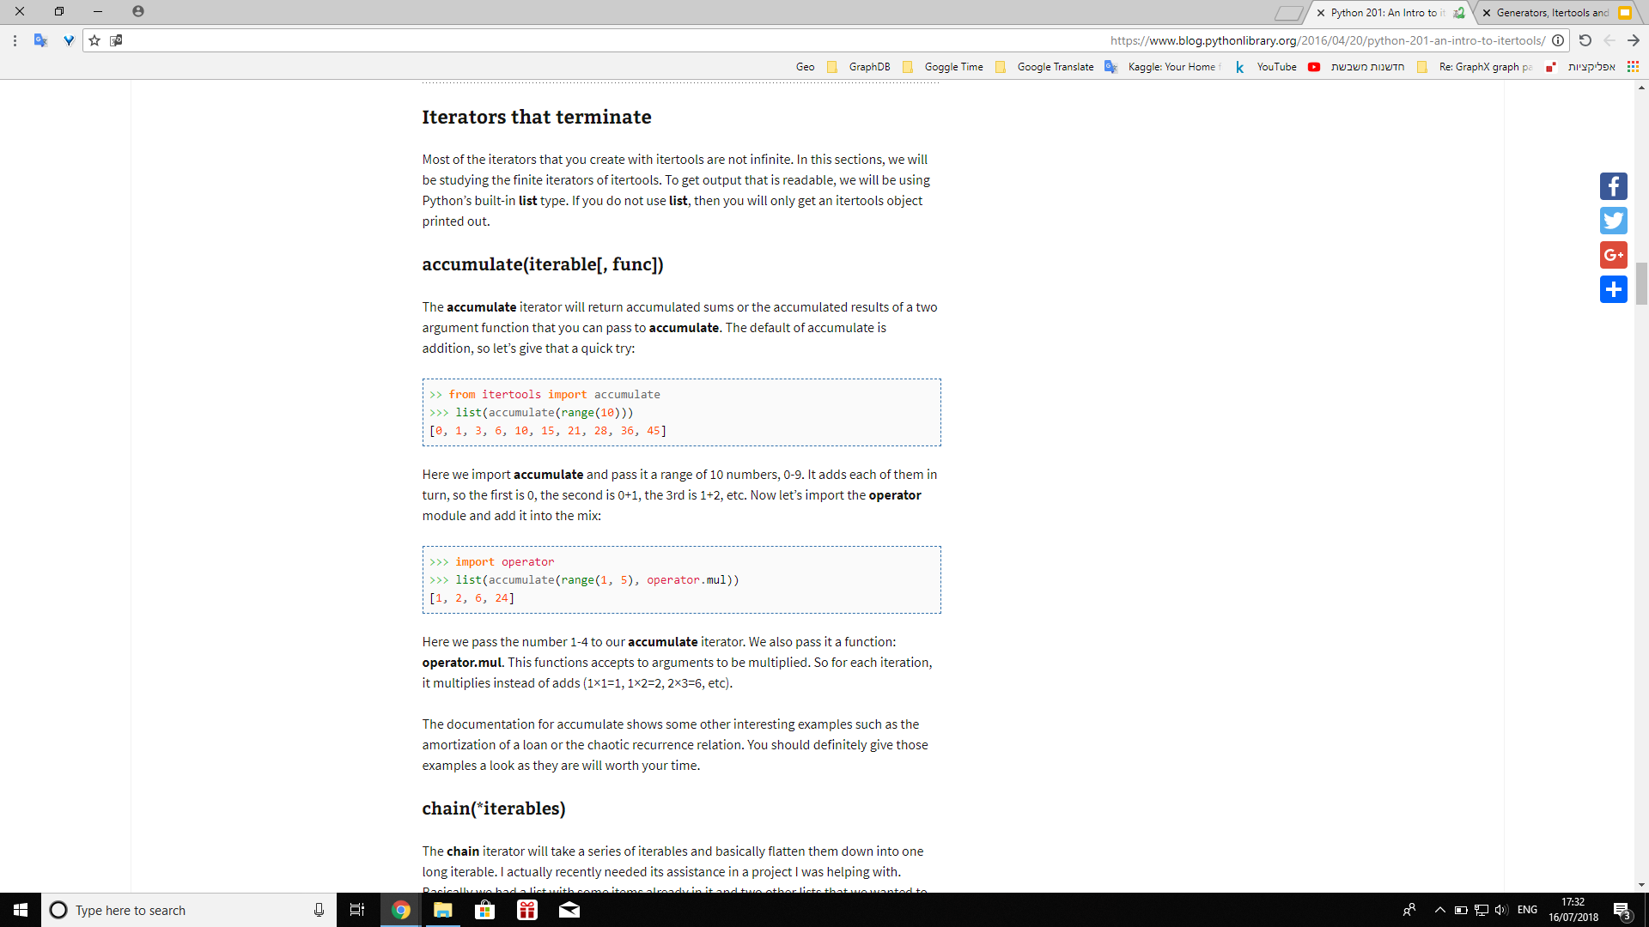
accumulate

Slide 9
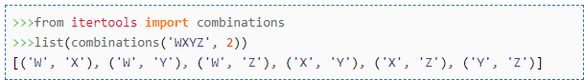
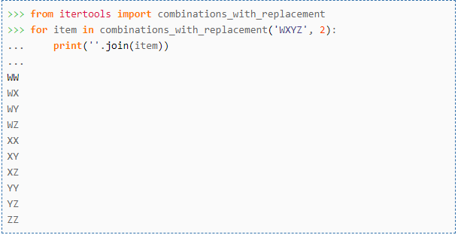
combinations (with replacement)

Slide 10
combinations (with replacement)

Slide 11
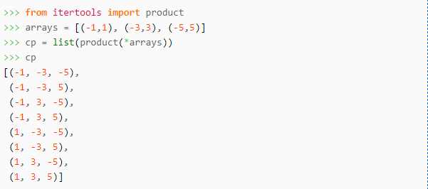
product

Slide 12
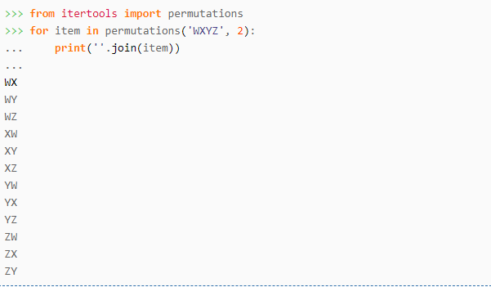
permutations

Slide 13
Decorators

Slide 14
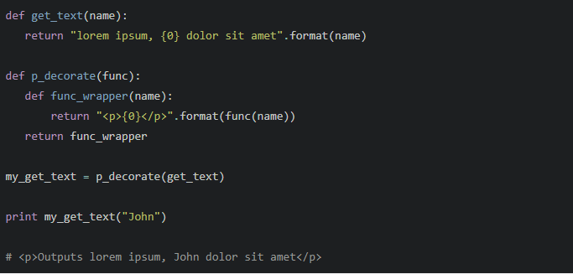
Decorators

Slide 15
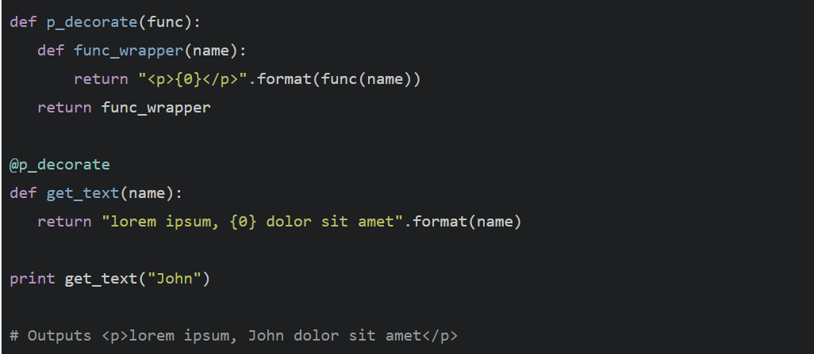
Decorators

